Slide 1
L1: Module 3
HIMANSHU ARYA

Slide 2
Agenda
CI/CD A GENTLE INTRODUCTION
CLOUD BASICS
CONFIGURATION MANAGEMENT
DEPLOYMENT STRATEGIES
WHAT IS DEVOPS ?
INFRA AS CODE BASICS
LINUX
LINUX CUSTOM SCRIPT TASKS

Slide 3
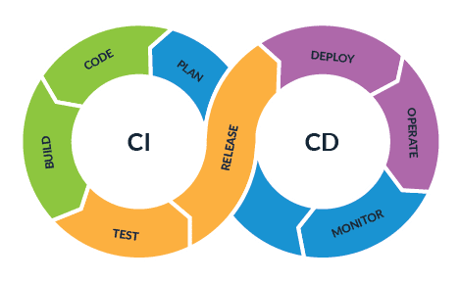
CI/CD
CONTINUOUS INTEGRATION
A practice where developers integrate their code into a common repository, preferably several times a day.
A series of scripts is run automatically to verify the changes that are pushed.
CONTINUOUS DEPLOYMENT/DELIVERY
A process that must happen after code is integrated for app changes to be delivered to users.
Advantages: Both the process are used for automating the building and deploying process.
What is CI/CD?
CI
CD

Slide 4
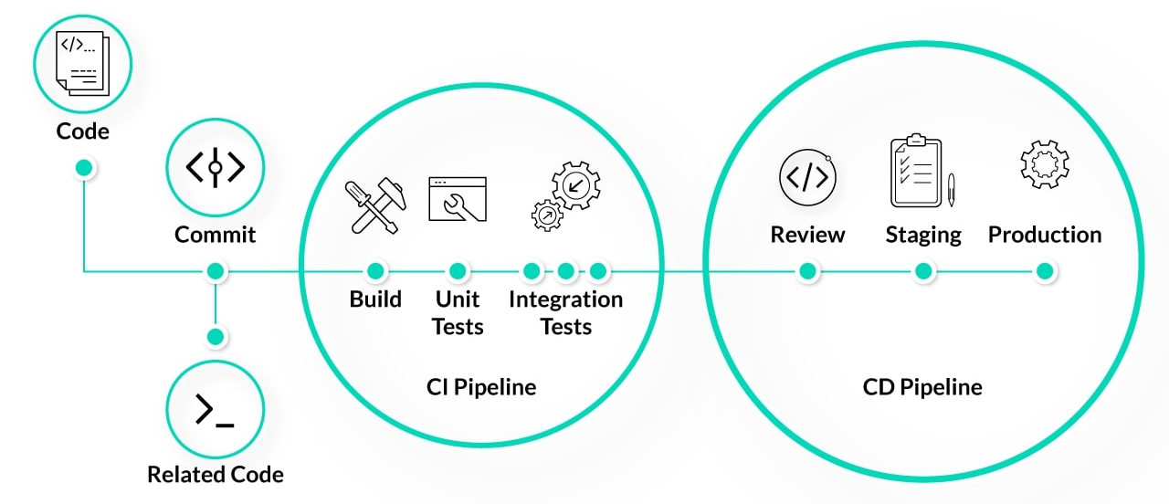
CI/CD
Benefits:
Smaller Code Changes.
Continuous Testing.
Early Fault Detections.
Smaller Backlog.
Customer Satisfaction.
Easy Maintenance and Updates.

Slide 5
CI/CD Tools
CI/CD relies on tools to achieve optimal workflows.
1. Jenkins
Jenkins is an automation server built to create a CI/CD environment for almost any combination of languages and repositories.
2. Spinnaker
Spinnaker is an open-source continuous delivery platform that integrates with major cloud providers, including AWS, Google Cloud, Microsoft Azure, and Oracle Cloud.

Slide 6
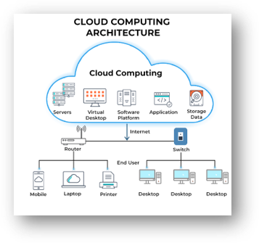
CLOUD
Cloud computing is the on-demand delivery of compute power, database, storage, applications, and other IT resources through a cloud services platform through the internet with pay-as-you-go pricing.
Advantages of cloud computing:
Pay as you go
Benefit from massive economies of scale
Stop guessing capacity
Increase speed and agility
Realize cost savings
Go global in minutes

Slide 7



CLOUD
There are different platform which provides the cloud computing facilities.
These platforms are:
Amazon Web Services (AWS)
Google Cloud
Azure

Slide 8
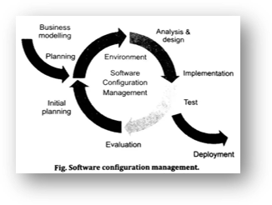
CONFIGURATION MANAGEMENT
Configuration Management is a critical system engineering process that helps organizations establish, monitor, and maintain computer systems, servers, and software in a desired, consistent state, allowing teams to build a consistent workflow.
It involves a high degree of automation that facilitates orderly management of system information and changes, provides visibility and control of its performance and functionality, and verifies whether the system performs as intended, among other benefits.

Slide 9
CONFIGURATION MANAGEMENT
Process of Configuration Management:
It Comprises five distinct disciplines that are used-
Planning & Management
Configuration Identification
Configuration Control
Configuration Status Accounting
Configuration Verification & Audit

Slide 10
DEPLOYMENT STRATEGIES
There are 6 Deployment Strategies for Software Deployment we have:
Recreate: Version A is terminated then version B is rolled out.
Ramped (also known as rolling-update or incremental): Version B is slowly rolled out and replacing version A.
Blue/Green: Version B is released alongside version A, then the traffic is switched to version B.
Canary: Version B is released to a subset of users, then proceed to a full rollout.
A/B testing: Version B is released to a subset of users under specific condition.
Shadow: Version B receives real-world traffic alongside version A and doesn’t impact the response.

Slide 11
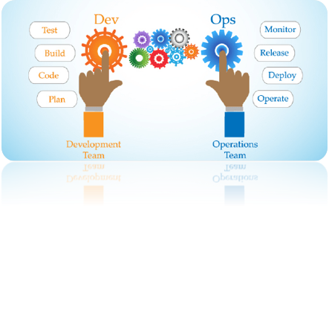
WHAT IS DEVOPS ?
DevOps is a process in which Modern software engineering Culture and Practices develop software where the development and operation teams work hand in hand as one unit, unlike the traditional ways; it is called the Agile Methodology.

Slide 12
INFRA AS CODE BASICS
Infrastructure as code is a mainstream pattern for managing infrastructure with configuration files rather than through a graphical user interface or through manual command line script sequences.
It allows you to build, change, and manage your infrastructure in a safe, consistent, trackable, and repeatable way by defining resource configurations that you can version, reuse, and share.

Slide 13
Linux
Just like Windows, iOS, and Mac OS, Linux is an operating system.
Linux has several different versions to suit any type of user.
These versions are called distributions (or, in the short form, “distros”).
Nearly every distribution of Linux can be downloaded for free, burned onto disk (or USB thumb drive), and installed (on as many machines as you like).
Popular Linux distributions include:
DEBIAN
UBUNTU
FEDORA

Slide 14
Linux
There are different CLI Command of Linux:
Linux Commands | Functions
ls | Displays information about files in the current directory.
pwd | Displays the current working directory.
mkdir | Creates a directory.
cd | To navigate between different folders.
rmdir | Removes empty directories from the directory lists.
cp | Copy files from one directory to another.
mv | Rename and Replace the files
rm | Delete files
uname | Command to get basic information about the OS
touch | Create empty files
ln | Create shortcuts to other files

Slide 15
Linux
There are different CLI Command of Linux:
Linux Commands | Functions
cat | Display file contents on terminal.
clear | Clear terminal
man | Access manual for all Linux commands
grep | Search for a specific string in an output
echo | Print string or text to the terminal
wget | download files from the internet.
whoami | Displays the current username
sort | sort the file content
cal | View Calendar in terminal
whereis | View the exact location of any command typed after this command
wc | Check the lines, word count, and characters in a file using different options.

Slide 16
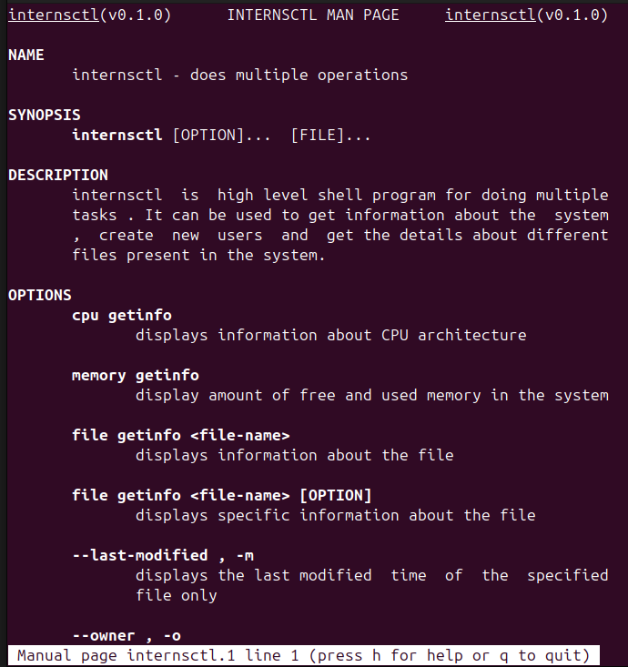
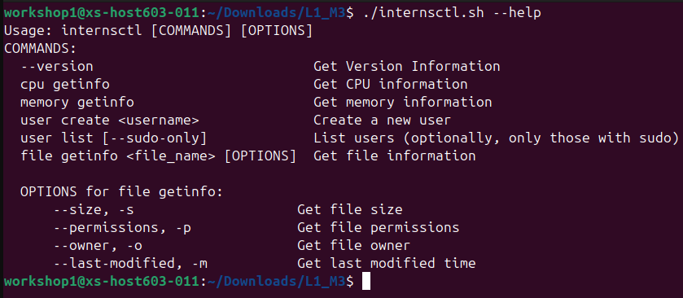
LINUX CUSTOM SCRIPT TASKS
Section A:
$ man internsctl
$ internsctl --help
$ internsctl --version

Slide 17
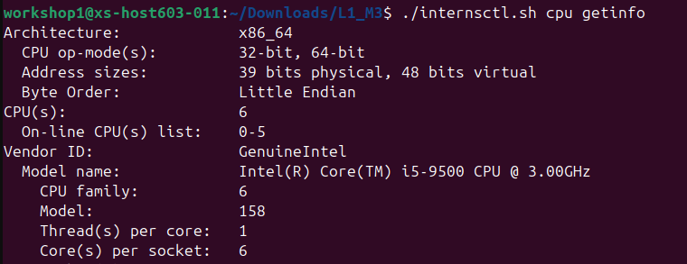
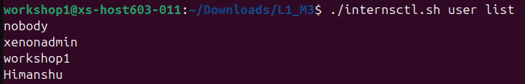
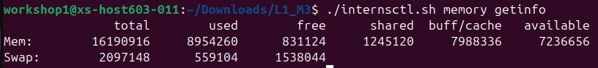
LINUX CUSTOM SCRIPT TASKS
Section B:
Part1 | Level Easy
Part2 | Level Intermediate
$ internsctl cpu getinfo
$ internsctl user create <username>
$ internsctl user list
$ internsctl memory getinfo
$ internsctl user list --sudo-only

Slide 18
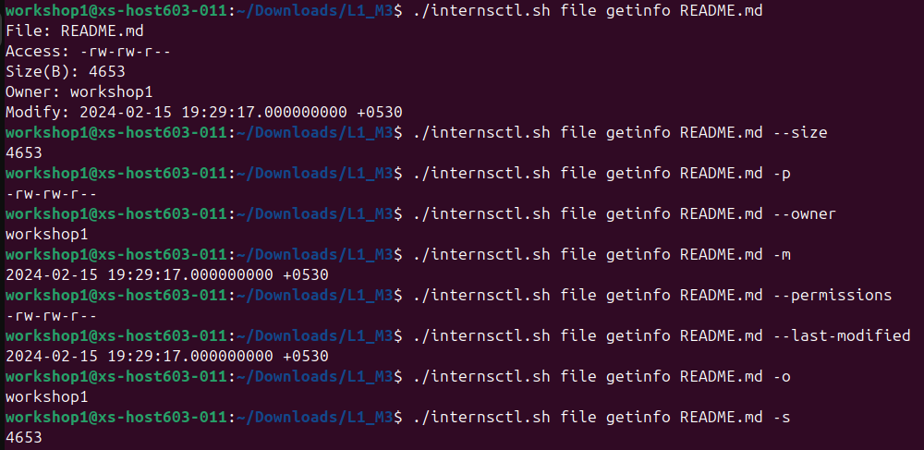
LINUX CUSTOM SCRIPT TASKS
Section B:
Part3 | Advanced Level
$ internsctl file getinfo <file-name>
$ internsctl file getinfo <file-name> [options]
[options]:
--size or –s
--permissions or –p
--owner or –o
--last-modified or -m

Slide 19
Thank you
ASSOCIATE SOFTWARE ENGINEER
HIMANSHU@XENONSTACK.COM

